Slide 1
EE 475 TERM PROJECT FINAL PRESENTATION
Gender and Age Estimation Based on Facial Features
Ege sarıça & hasan emre kayır

Slide 2



The Project ın a nutshell
Gender classification, age regression output:
Prediction 1: Age: 28.3 Gender: 1
Prediction 2: Age: 28.8 Gender: 0
27/1 27/0

Slide 3
Our ımplementatıon steps
Chosing the appropriate dataset
Parsing the information of dataset (Age, gender)
Face Detection using Viola-Jones algorithm
Preprocessing
Face features adaptation
PCA
Estimation
Results and performance measure

Slide 4
Chosing the appropriate dataset
Dataset we use to train the machine learning algorithm has huge importance for this project. Number of images is our main concern. Larger number of images is better for algorithm to have less error. Yet, it takes long time to process large data. Thus, our data should both give good results and be operation friendly.

Slide 5
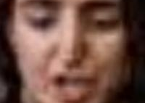

DATABASE WE HAVE USED
First subset of UTKFaces: Contains 600 images and used for testing the basic results of our algorithm.
Second subset of UTKFaces: Contains 2448 images and used for performance evaluation of the algorithm concerning blurred, rotated, bad quality images.

Slide 6
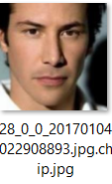
ParsIng the InformatIon of dataset
Images in UTKFaces dataset is labeled like this. 28: Age, 0: Male, 0: Race(White)
We created a function called extract_labels:
function [age, gender] = extract_labels(filename)
split_name = split(filename, '_');
age = str2double(split_name{1});
gender = str2double(split_name{2});
end

Slide 7
Face features adaptation
Facial features that can be used for gender and age estimation are:
Gradient
Hessian
Histogram of the Oriented Gradients
Ratios of face parts,
Wrinkles
Hair, beard, moustache

Slide 8


Face features adaptation
Adding high number of features slows down the algorithm process. Also, sometimes these features may increase error. A man may not have beard or moustache for example, or a woman may have.

Slide 9
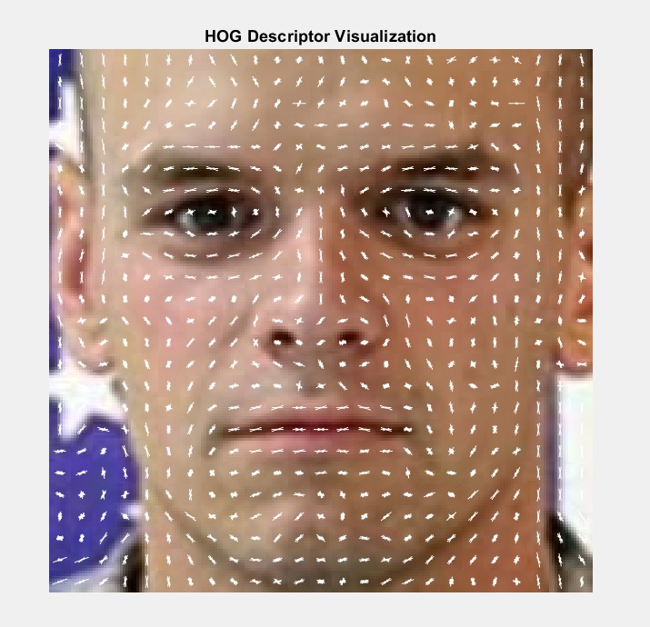
HISTOGRAM OF ORIENTED GRADIENTS
HOG counts occurrences of gradient orientation in localized portions of an image. For 200x200 image of our case:
Cell size 8x8= 25x25= 625 cells
Block size 2x2 = 24x24= 576 blocks
Orientation Bins (9)= histogram of gradient orientations is created with 9 bins
Each block, 4 cellx9 bins= 36 features, 576x36= 20736 features create an output vector

Slide 10

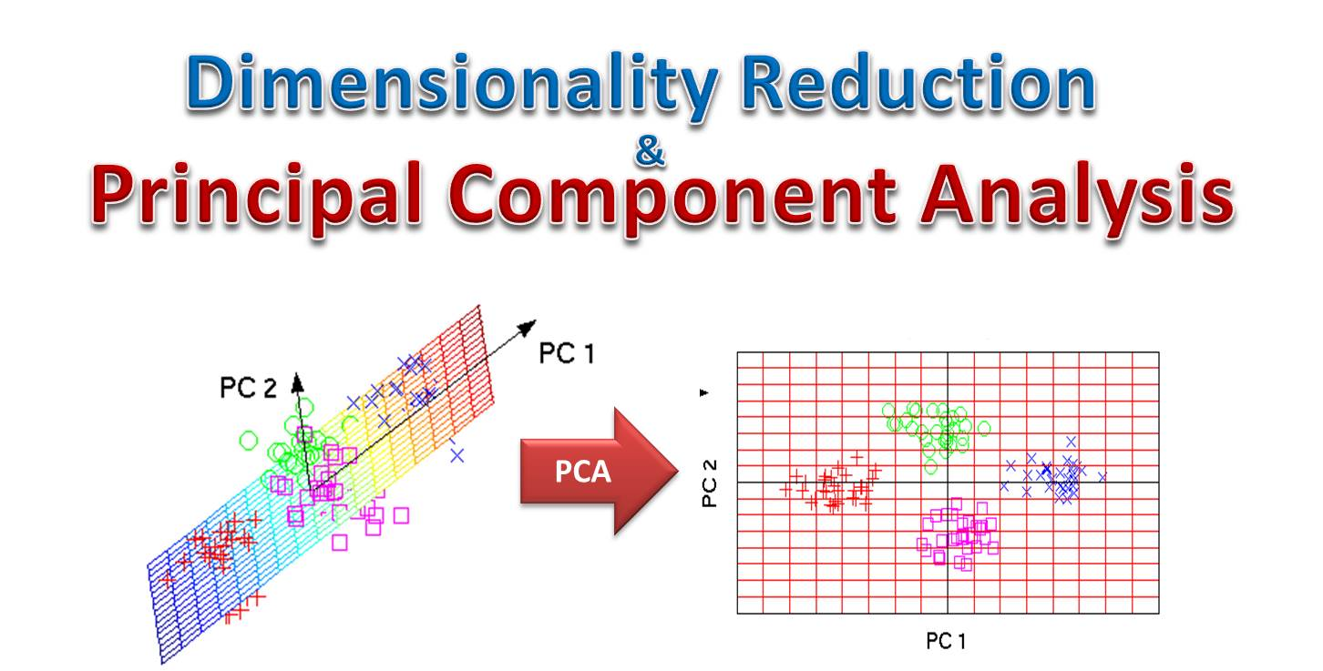
PCA
From 2448x20736 size to 2448x100 size using principal components and varience

Slide 11
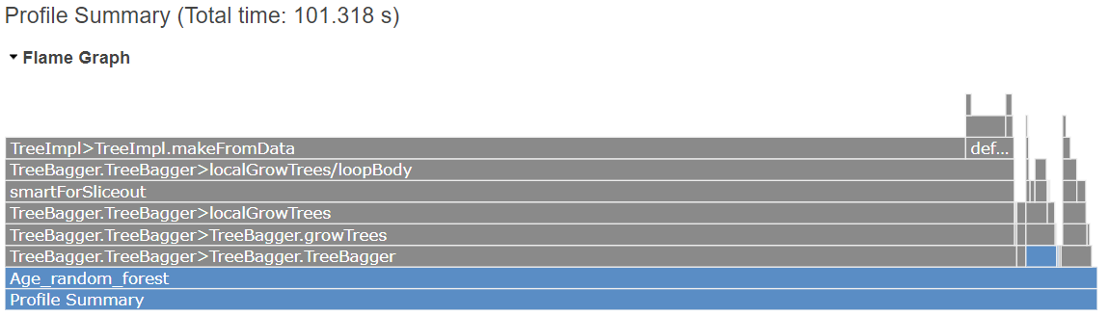
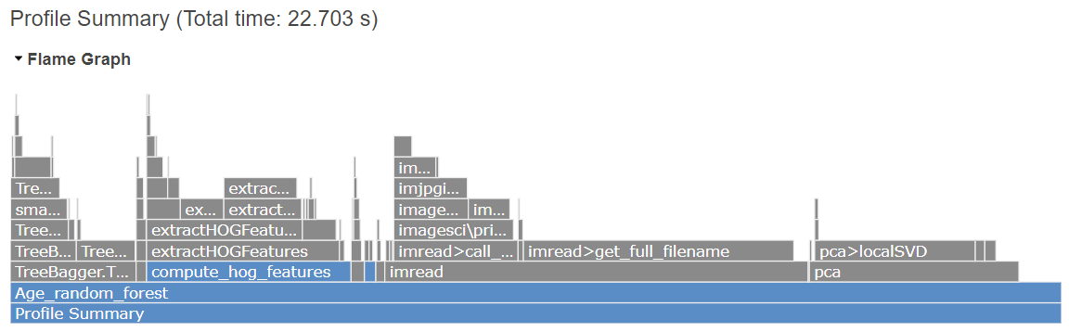
Mean absolute error without PCA:5.77
Working time: 101s
Mean absolute error with PCA: 5.85
Working time: 22.7s

Slide 12
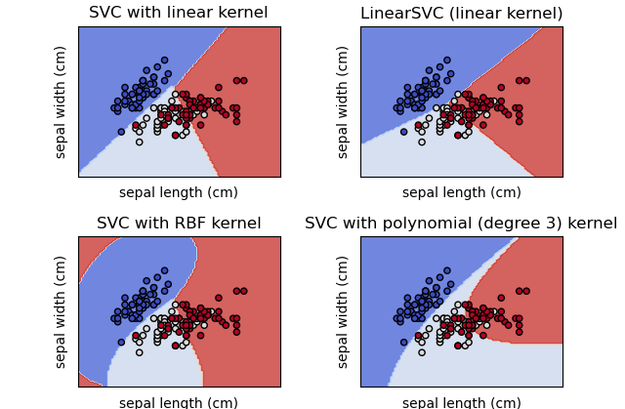
GENDER ESTIMATION
For gender estimation, Support Vector Machines (SVM) algorithm is used and algorithm is trained by the HOG of images.

Slide 13
GENDER ESTIMATION
Support Vector Machine (SVM) is a learning algorithm used for classification and regression tasks. It is suitable for gender estimation because it works well with a smaller dataset, and can model complex decision boundaries using kernel functions.

Slide 14
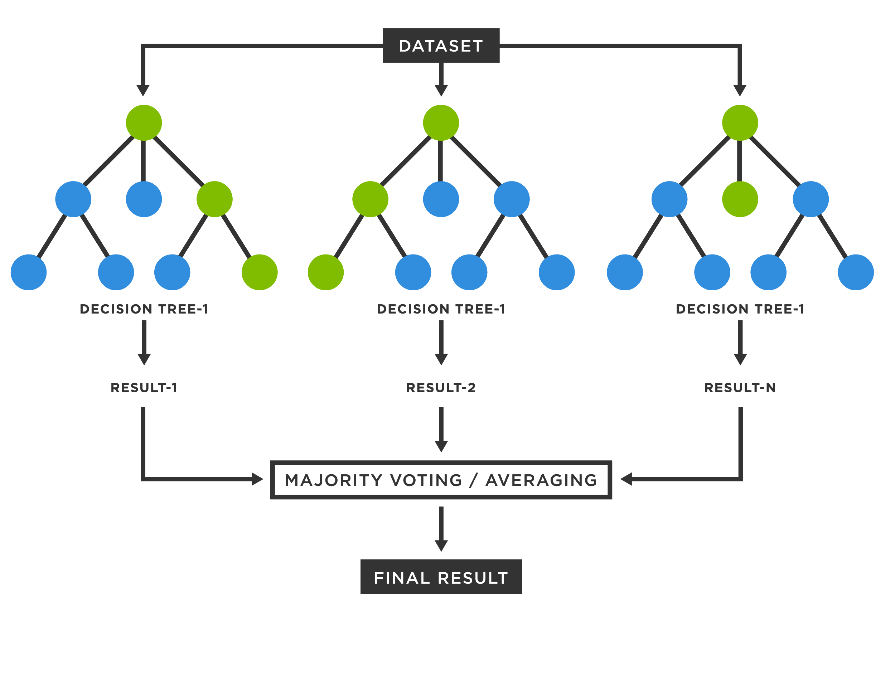
AGE ESTIMATION
Random Forest is a learning method that combines multiple decision trees to make more accurate predictions. It can handle non-linear relationships, estimate feature importance, and be parallelized for faster training.

Slide 15
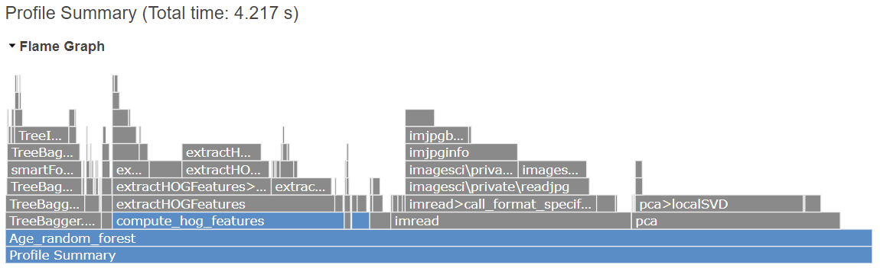
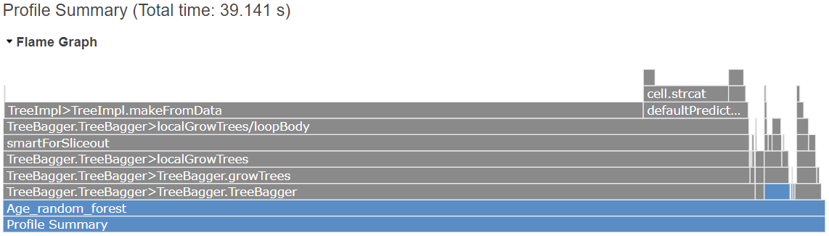
AGE ESTIMATION RESULTS
Mean absolute error: 3.13
Working time: 4.2s
Mean absolute error: 3.21
Working time: 39.1s
*Data with 600 images

Slide 16
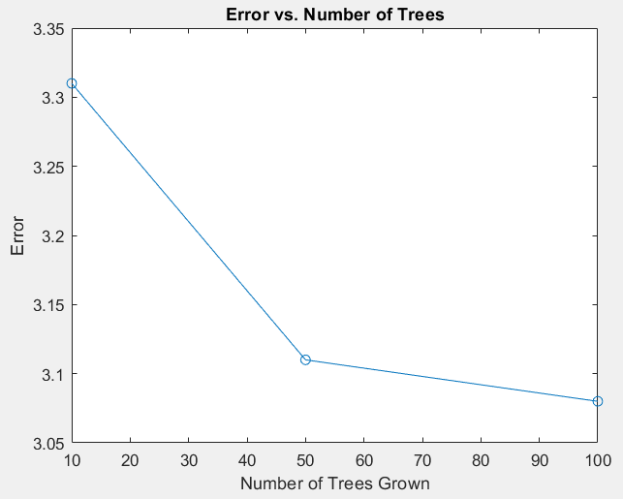
AGE ESTIMATION RESULTS
Mean Absolute Error: 3.08 For random forest with 100 trees
Mean Absolute Error: 3.11 For random forest with 50 trees
Mean Absolute Error: 3.31For random trees with 10 trees

Slide 17
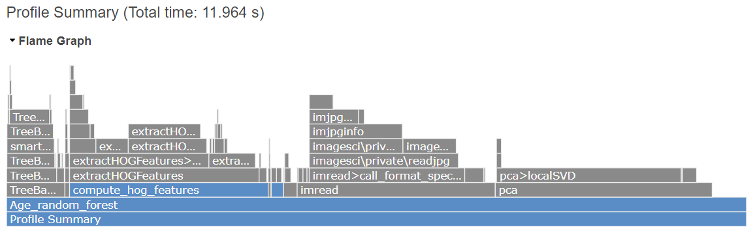
AGE ESTIMATION RESULTS
Mean absolute error without PCA: 5.77
Working time: 101s
Mean absolute error with
PCA: 5.72
Working time: 11.9s
*Data with 2448 images

Slide 18
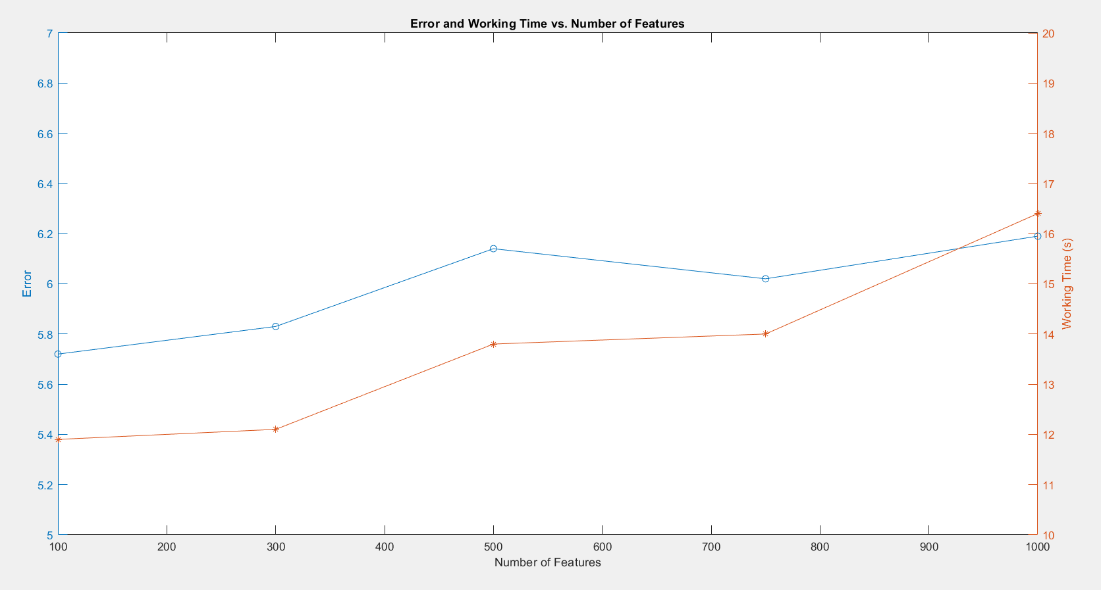
PCA Number of reduced features RESULTS
Taking into account the first 100 highest varience princable components give the best result for both error and working time

Slide 19
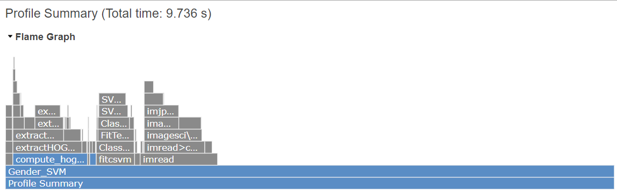
GENDER ESTIMATION RESULTS
Accuracy: %95.05 Working time: 9.7s

